Slide 1
SOCIAL MEDIA APP
Ardent Computech
DEPARTMENT COMPUTER SCIENCE
MAJOR PROJECT
MEMBERS:
1. Sanu Mondal
2. Aritra Ghosh
3. Saumyadeep Barman
4. Debarati Mahajan
5. Srijita Roy

Slide 2
01
SOCIAL MEDIA APP
Introducing Circle, the latest innovation in social media designed to transform how you connect and share. With Circle, you can effortlessly create, discover, and engage with content that truly matters to you. Our intuitive interface and unique features empower you to connect with friends, explore new interests, and join vibrant communities. Whether you're sharing moments, discovering trends, or networking professionally, Circle is your gateway to a richer and more dynamic online experience. Join us today and be part of the next evolution in social media!
A BRIEF INTRODUCTION OF OUR WEBSITE

Slide 3
02
OBJECTIVE
The objective of this presentation is to provide a comprehensive overview of our social media website project, highlighting its purpose, scope, and key features. We aim to convey the project's goals of creating a user-friendly and secure platform that fosters meaningful connections and interactions among users. Additionally, we will outline the functional requirements and demonstrate how they align with our vision for the platform.
Through this presentation, we seek to inform stakeholders about the current progress, future scope, and potential enhancements that will keep the platform dynamic and engaging. By the end of this presentation, attendees will have a clear understanding of the project's direction, the benefits it offers to users, and the strategic plans in place for ongoing development and improvement.

Slide 4
03
ABSTRACTION
This project focuses on developing a social media website that prioritizes user engagement, security, and ease of use. At its core, the platform will offer essential features such as user registration, profile management, content sharing, and direct messaging. The goal is to create a simple yet robust environment where users can connect, share, and communicate effectively.
The project's scope includes implementing basic functionalities with a strong emphasis on privacy and security, ensuring that user data is protected. Future enhancements will build on this foundation, incorporating advanced content discovery, community-building features, and improved user interface designs. By continuously evolving based on user feedback and technological advancements, the platform aims to remain relevant and valuable to its users, fostering a positive and inclusive online community.

Slide 5
04
MERITS
1. User Engagement and Connectivity
Enhanced Interaction: Fosters meaningful connections through direct messaging, profile management, and content sharing.
Community Building: Encourages connections with like-minded individuals, creating a sense of community and belonging.
2. User-Friendly Design
Intuitive Interface: Provides a straightforward and easy-to-navigate design for a positive user experience.
Customizable Profiles: Allows users to personalize their profiles, enhancing their online identity and engagement.
3. Security and Privacy
Data Protection: Ensures user data privacy and safety through robust security measures such as encryption and secure authentication.
Content Moderation: Maintains a respectful and positive environment with effective content moderation tools.
4. Scalability and Future Enhancements
Scalability: Designed to support future growth and integration of new features and technologies.
Continuous Improvement: Regular updates based on user feedback ensure the platform evolves to meet changing needs and preferences.

Slide 6
05
DE-MERITS
Limited Initial Features
Basic Functionalities: Initial version may lack advanced features like video sharing and content monetization, potentially limiting appeal.
Initial Language Support: May support only a single language at launch, limiting accessibility for a global audience.
2. Resource Intensive
Development and Maintenance: Building and maintaining a secure, scalable platform requires significant time, effort, and financial resources.
User Support: Providing continuous user support and managing feedback can be resource-intensive.
3. Market Competition
Competitive Landscape: High competition in the social media space makes gaining user traction challenging.
User Retention: Keeping users engaged and preventing them from switching to other platforms requires continuous innovation.
4. Privacy Concerns
User Data Handling: Even with robust security measures, handling user data responsibly is critical to avoid damaging the platform's reputation.
Regulatory Compliance: Adhering to various data protection regulations across different regions can be complex and demanding.

Slide 7
06
SCOPE
The various objectives of the Social Media Website can be laid as follows:
Connect Users: Facilitate connections between individuals, enabling them to interact with friends, family, and
like-minded people across the globe.
Content Sharing: Provide a platform for users to share various types of content, such as text updates, photos, videos,
and links, fostering creative expression and communication.
Community Building: Create spaces for users to join and participate in communities or groups based on shared
interests, hobbies, or professional fields.
Engagement and Interaction: Encourage active participation through features like likes, comments, shares, and
messaging, promoting ongoing engagement and conversation.

Slide 8
07
SYSTEM REQUIREMENT
HARDWARE REQUIREMENT:
• | PROCESSOR | Dual core and above
• | RAM / ROM | 10 Gb of free disk space & minimum 8Gb of RAM
• | MOTHERBOARD | INTEL
SOFTWARE REQUIREMENT:
•OPERATING SYSTEM | Windows 10, 11
•PROG.LANGUAGE | HTML, CSS, JS, React
•DATABASE | MONGODB
•IDE USED | VS Code

Slide 9
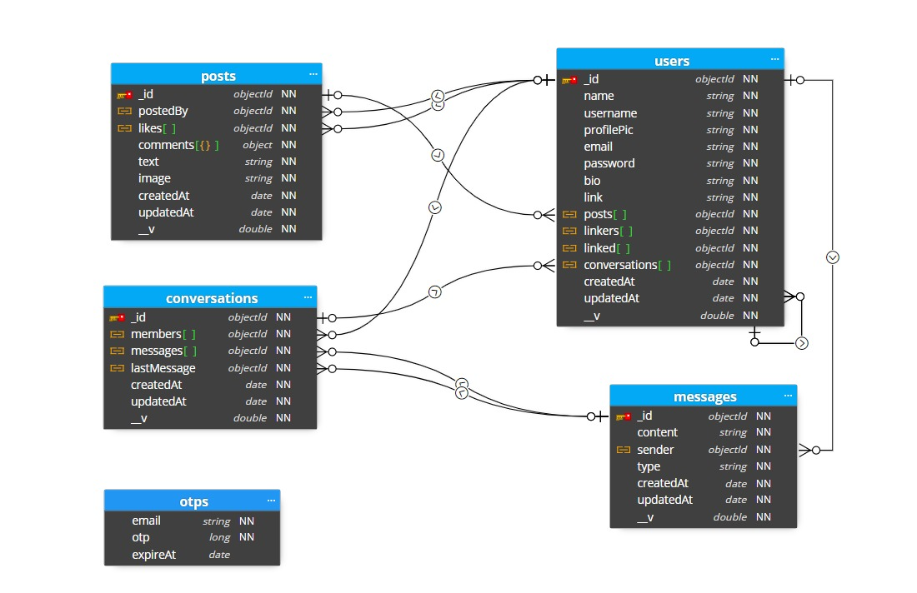
08
SCHEMA DIAGRAM

Slide 10
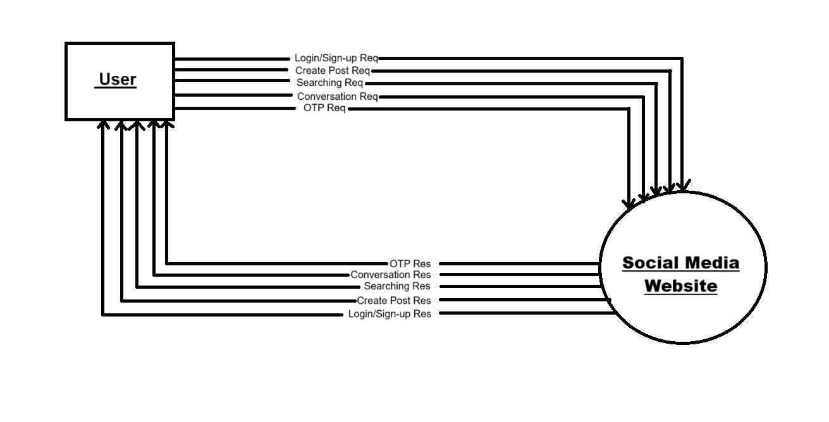
09
0 LEVEL DFD

Slide 11
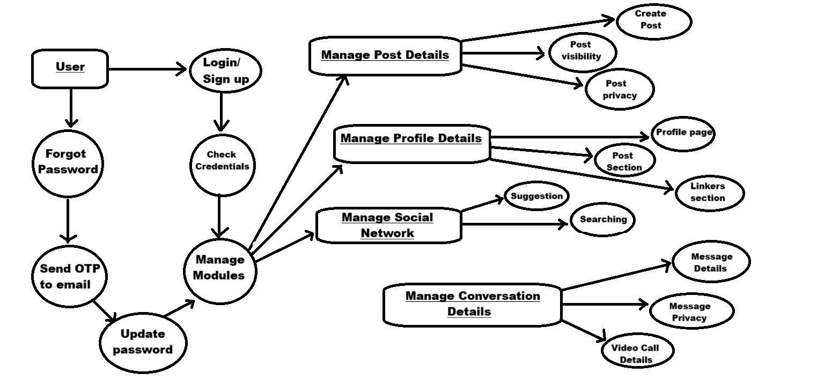
10
1 LEVEL DFD

Slide 12

PROJECT’S UI

Slide 13
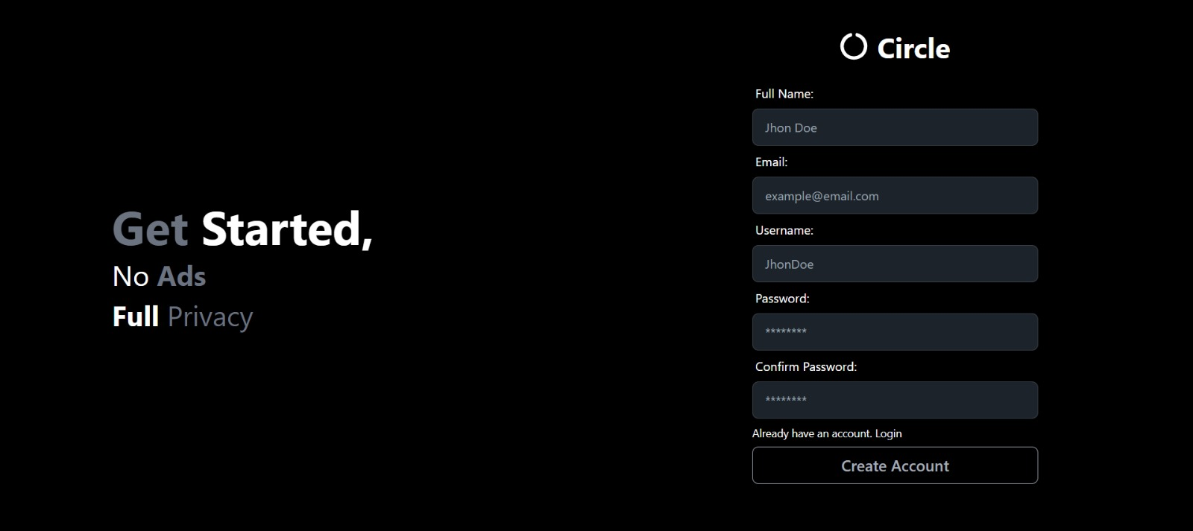
11
CREATE ACCOUNT

Slide 14
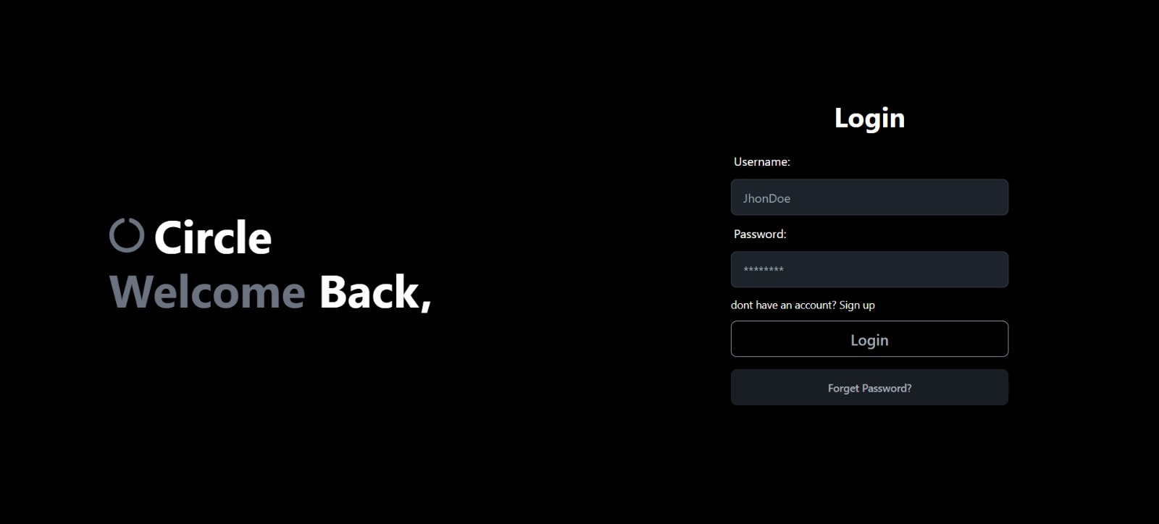
12
LOGIN PAGE

Slide 15
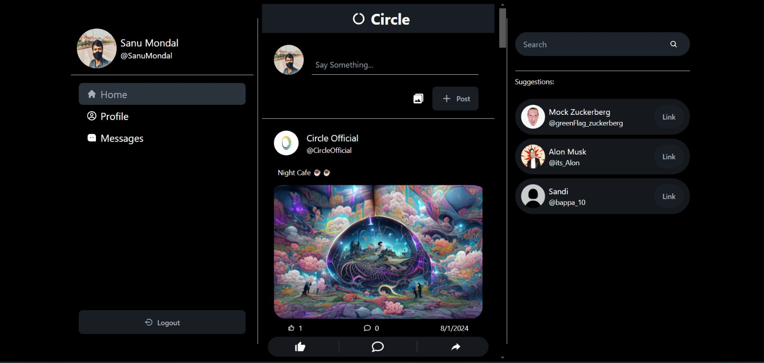
13
HOME PAGE

Slide 16
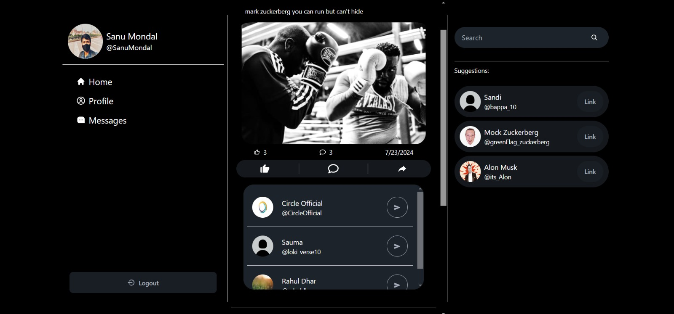
14
SHARING POSTS

Slide 17
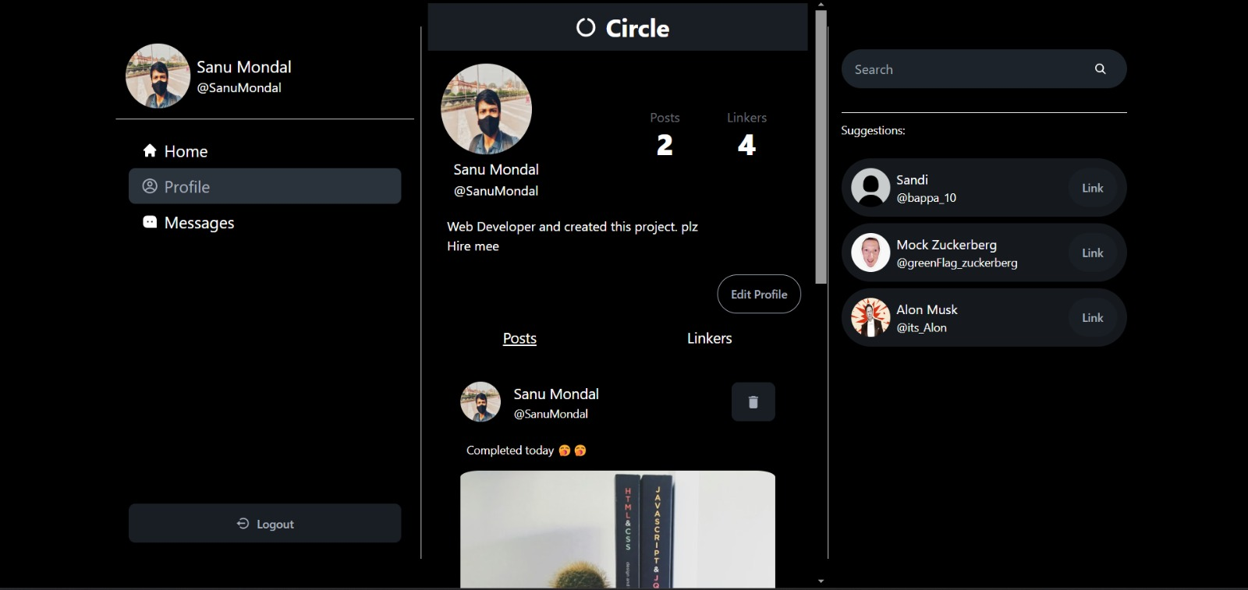
15
PROFILE PAGE

Slide 18
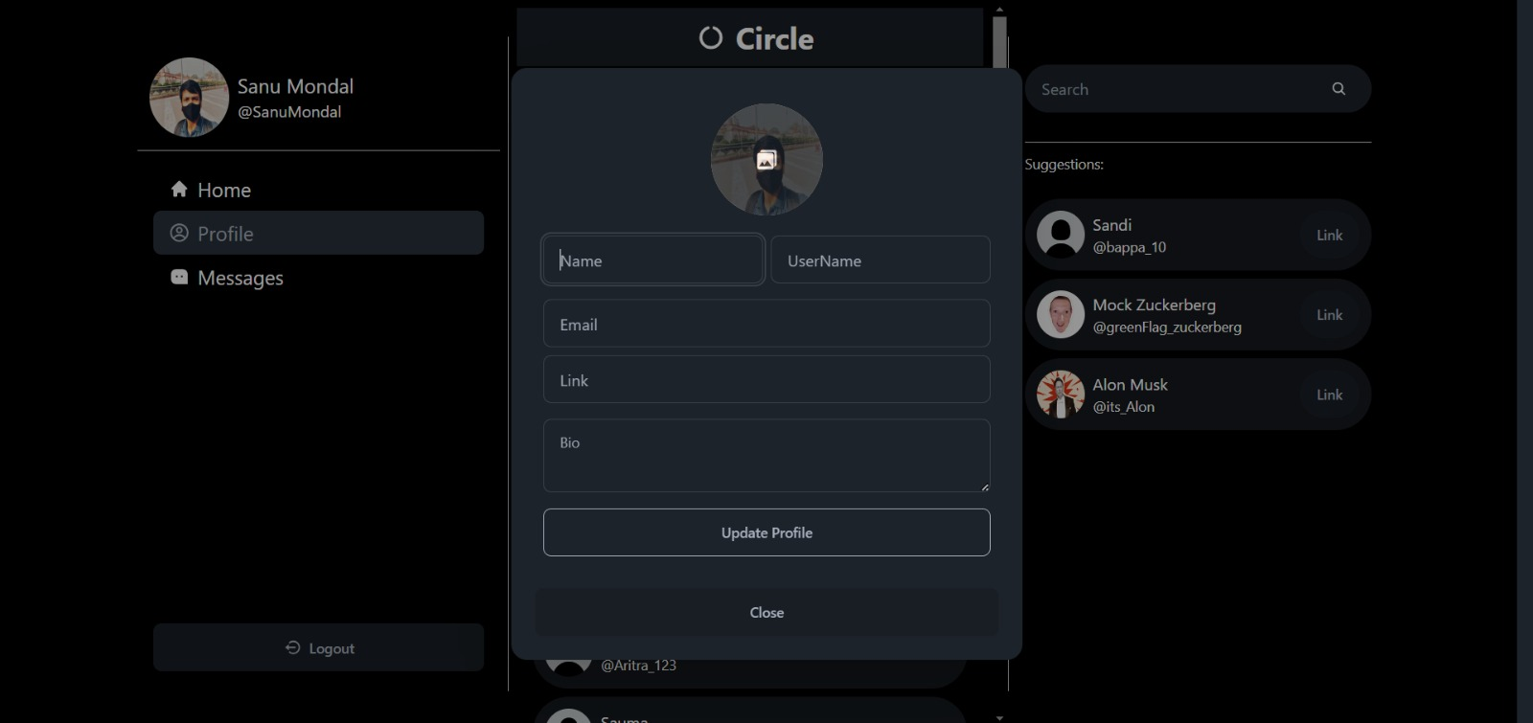
16
EDIT PROFILE

Slide 19
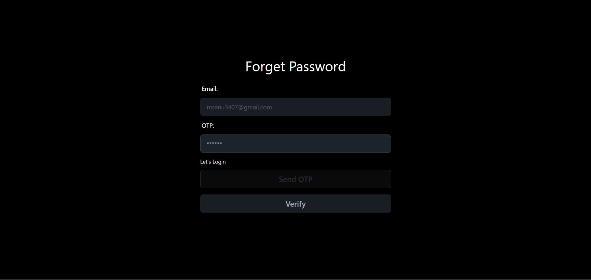
17
FORGET PASSWORD

Slide 20
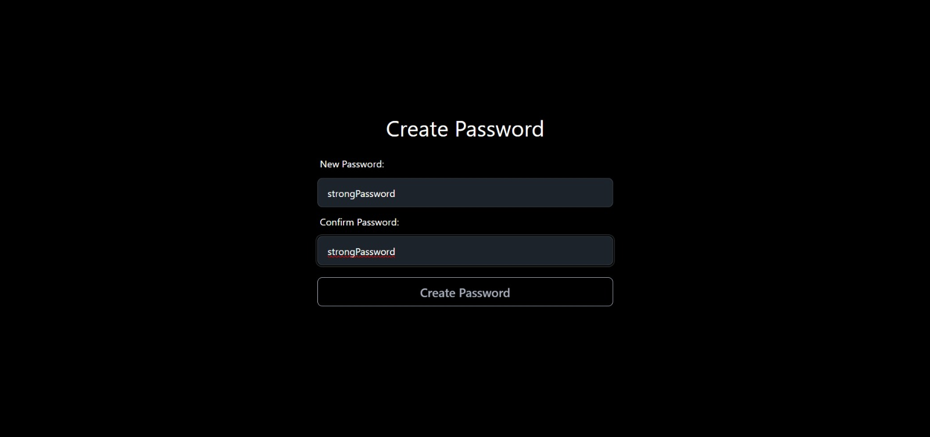
18
CHANGING PASSWORD

Slide 21
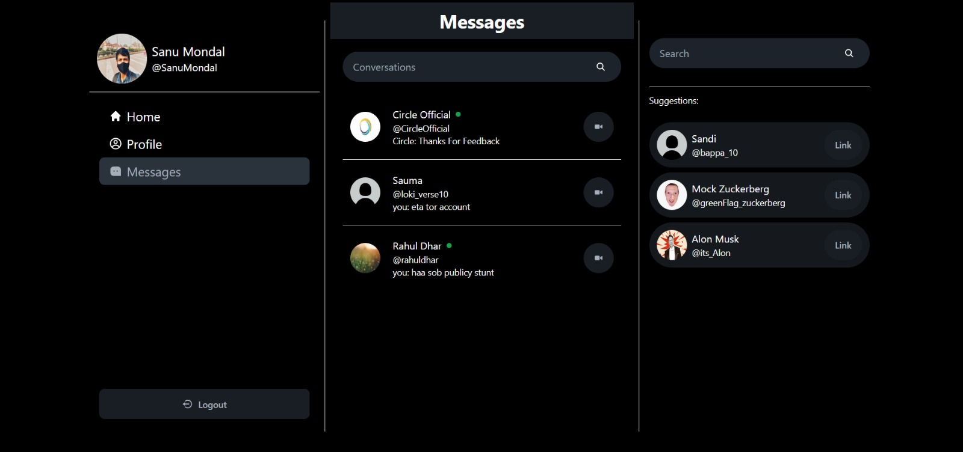
19
CHATBOX (MESSAGES)

Slide 22
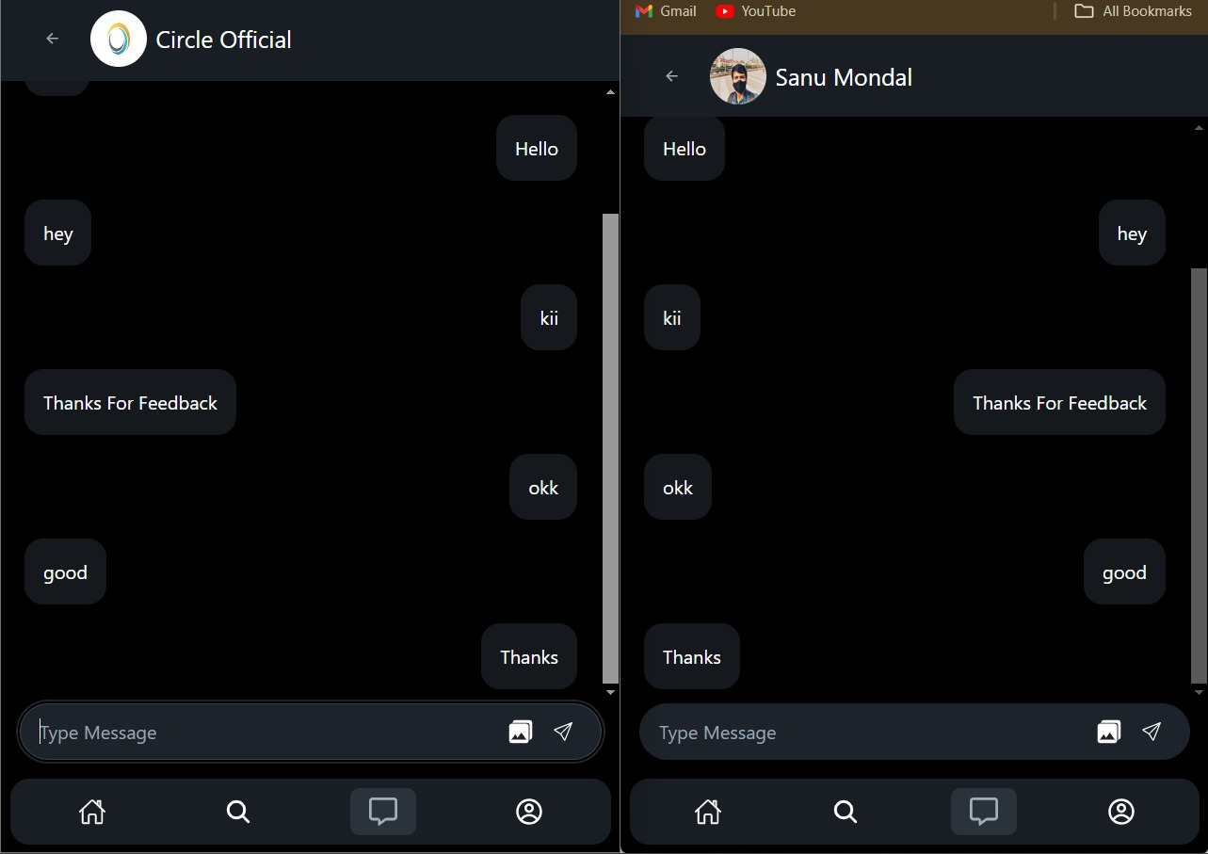
20
REAL-TIME MESSAGING

Slide 23
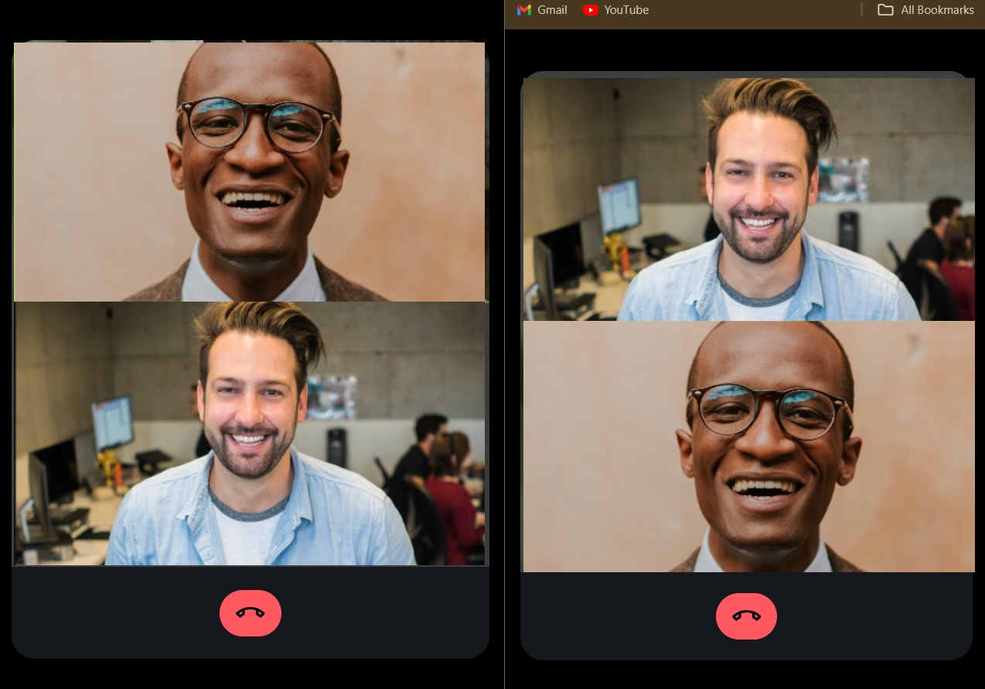
21
VIDEO CALLING FEATURE

Slide 24
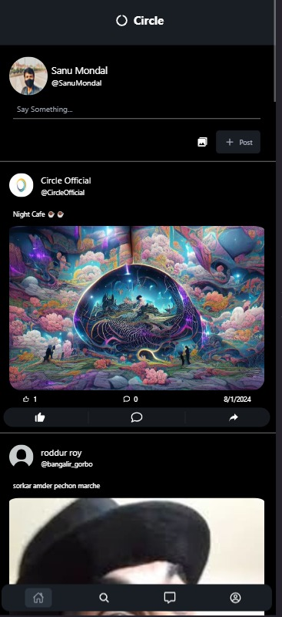
22
MOBILE VIEW

Slide 25
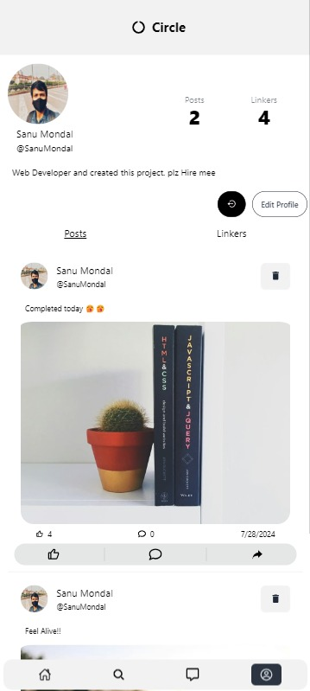
23
CHANGING THEMES

Slide 26
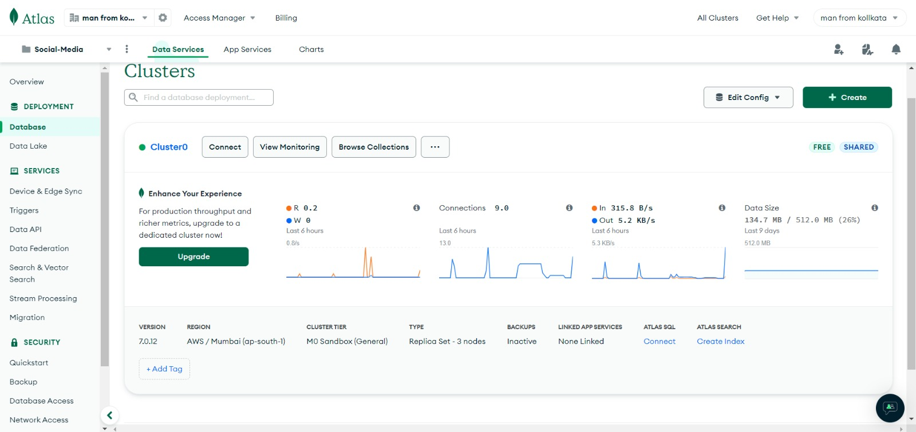
24
DATABASE

Slide 27
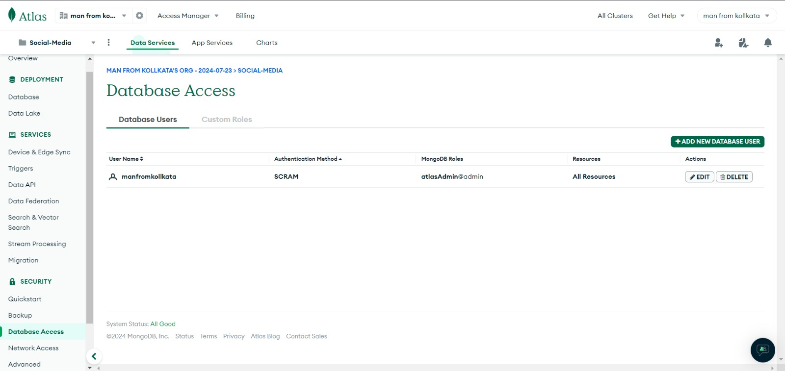
25
USER DATABASE

Slide 28
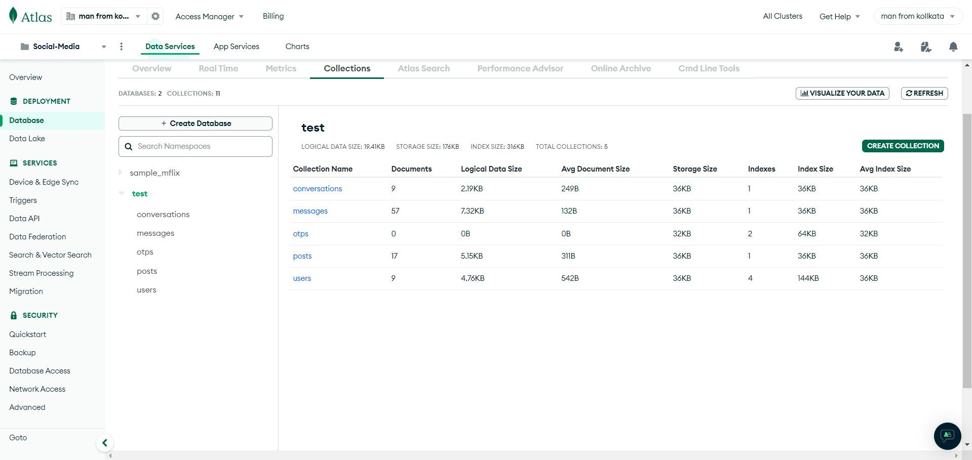
26
COLLECTIONS

Slide 29
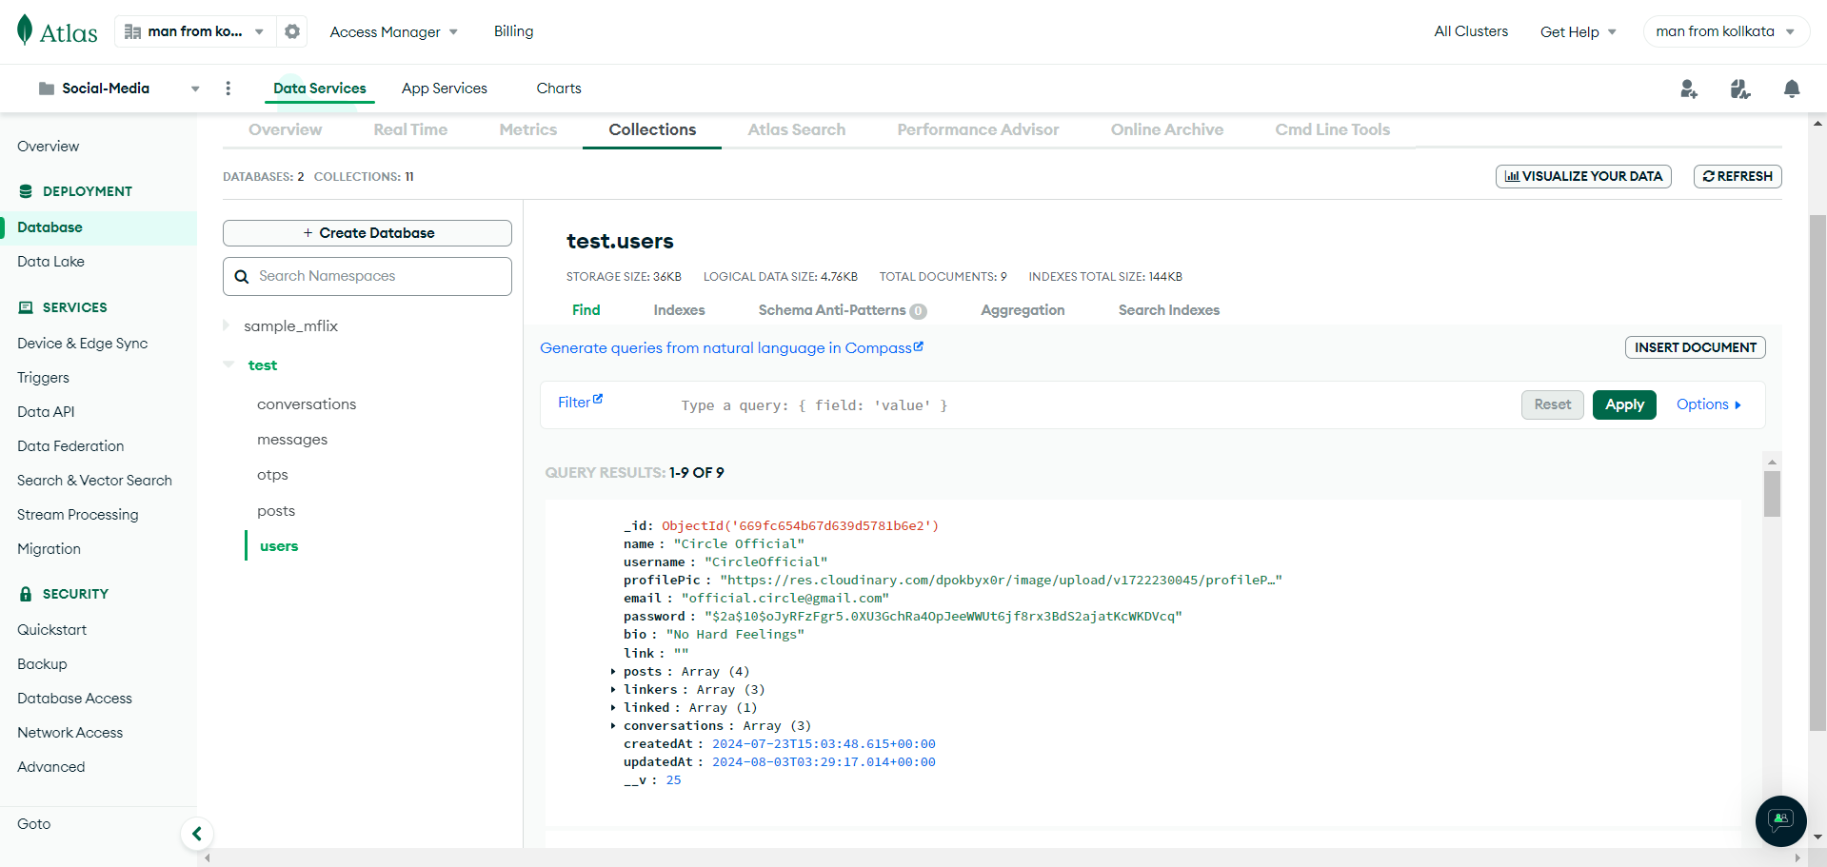
27
USER COLLECTIONS

Slide 30
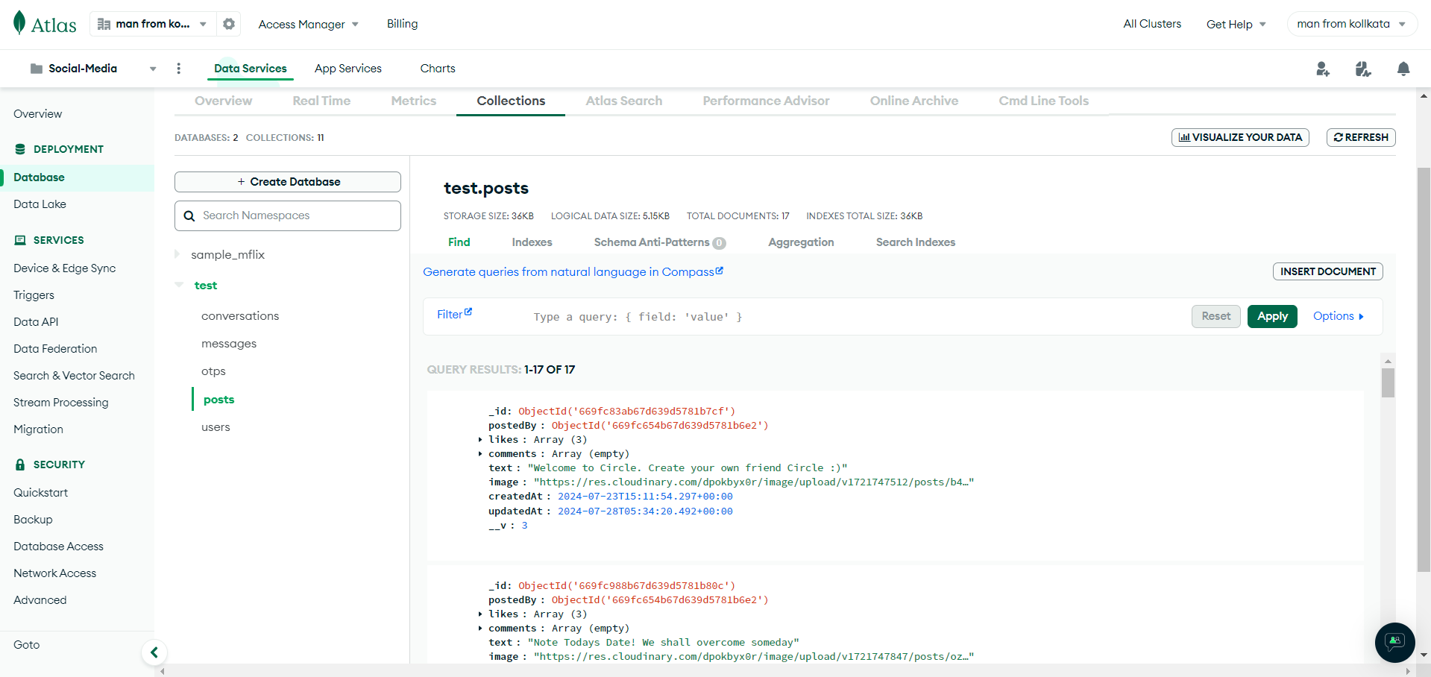
28
POST COLLECTIONS

Slide 31
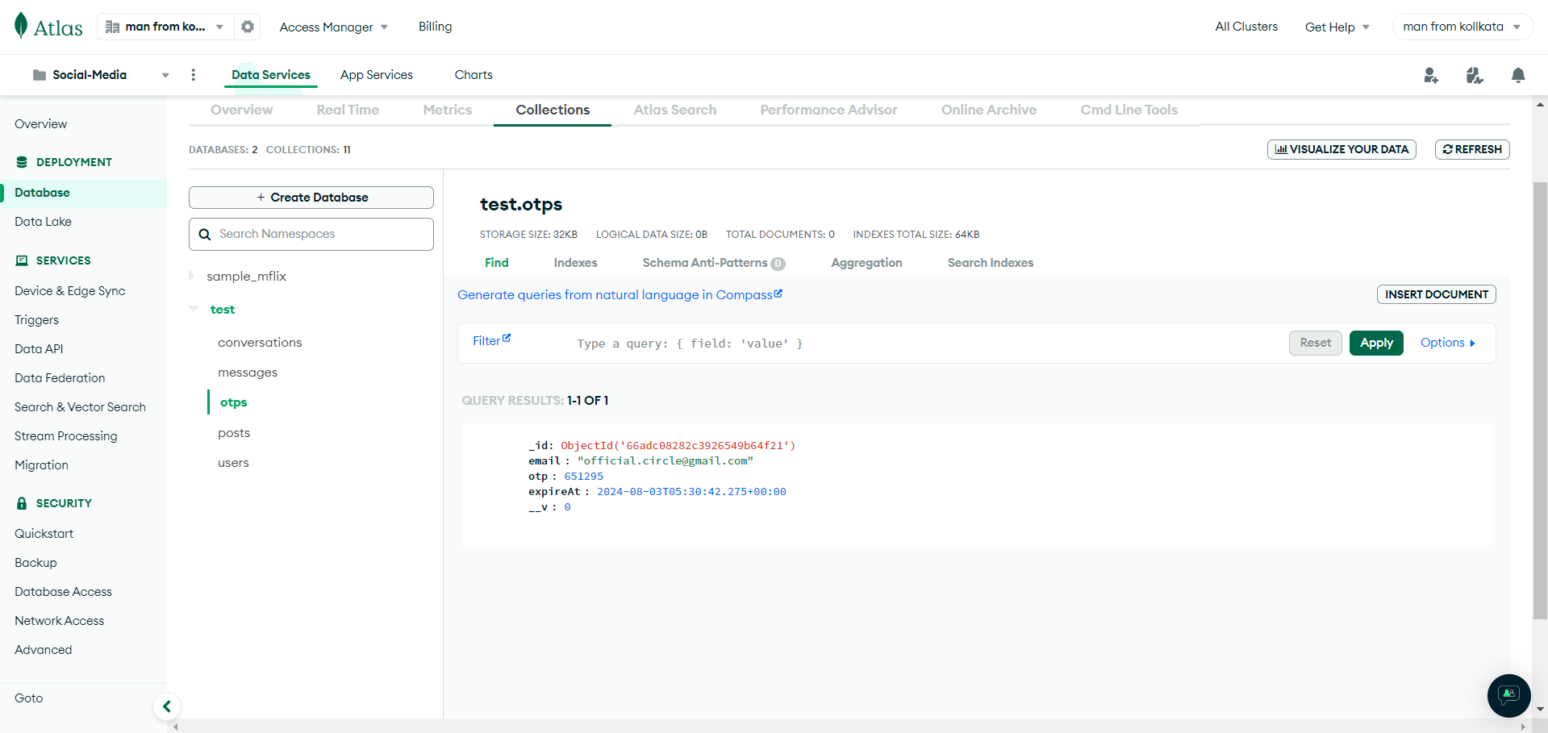
29
OTP COLLECTIONS

Slide 32
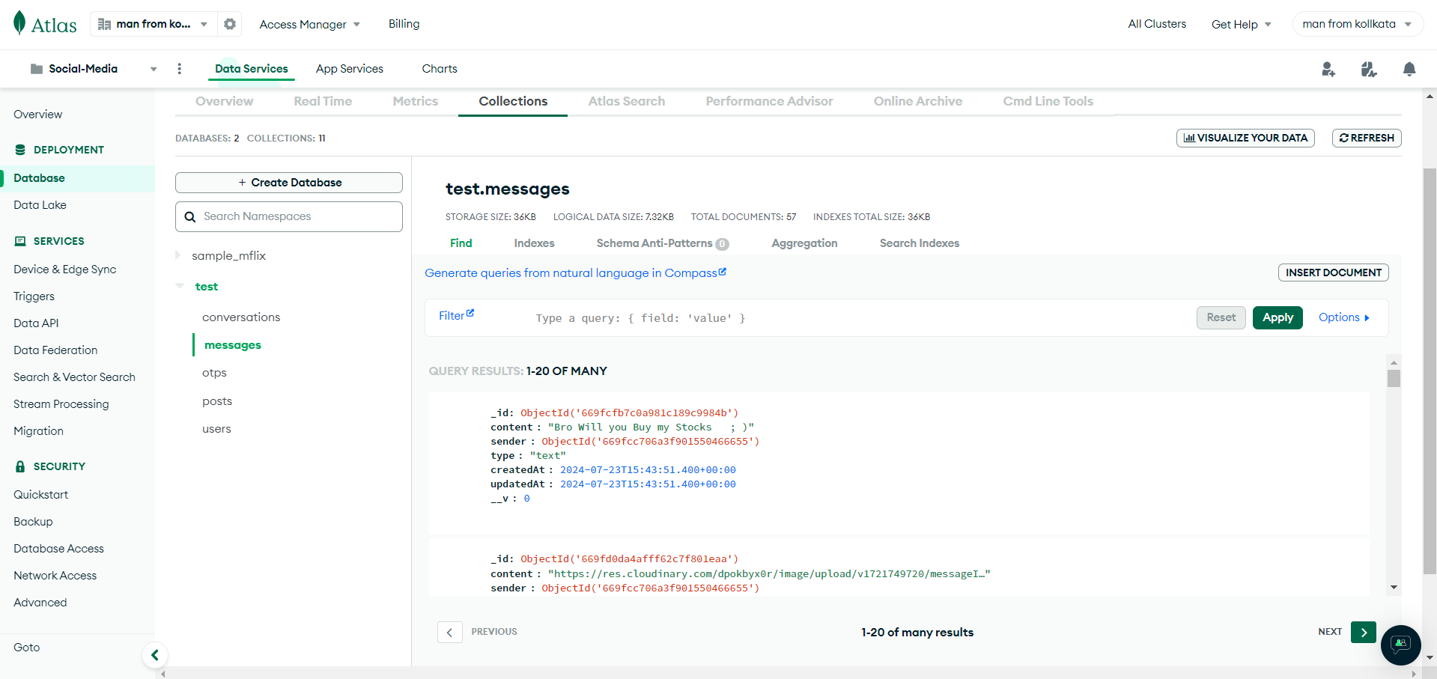
30
MESSAGE COLLECTIONS

Slide 33
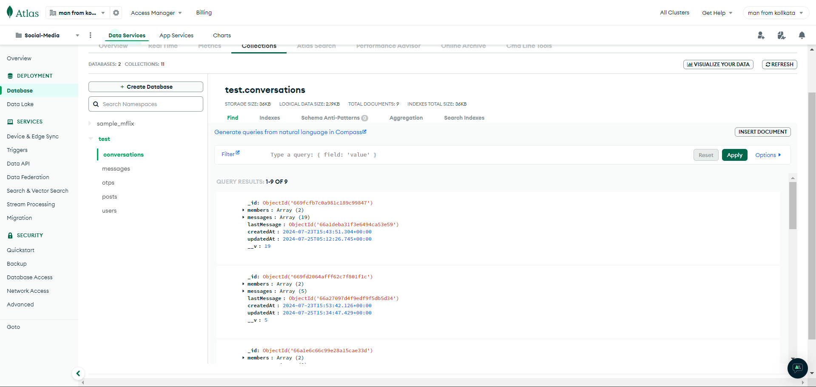
31
CONVERSATION COLLECTIONS

Slide 34
32
FUTURE SCOPE
The future scope of the Social Media website project includes:
Enhanced Personalization: In the near future Circle can use advanced algorithms and artificial intelligence to
deliver highly personalized content and recommendations, tailoring the user experience
based on individual preferences and behaviors.
Augmented Reality (AR) and Virtual Reality (VR): The integration of AR and VR technologies will create immersive
experiences, allowing users to interact in virtual spaces, try on products virtually, and
participate in live, interactive events.
Decentralization and Web3: The rise of decentralized technologies and blockchain will influence Circle, to
promote user ownership, transparency, and control over data. This could lead to the
creation of decentralized social networks with enhanced privacy and security.
AI-Driven Content Creation: AI tools can be implemented to make Circle more sophisticated, assisting users in
generating content, from automated video editing and enhanced photo filters to
AI-generated text and interactive experiences.
Increased Integration with E-Commerce: Circle will blur the lines between social interaction and shopping,
with advanced features for seamless in-app purchases, personalized shopping
experiences, and influencer-driven commerce.

Slide 35
Thanking You
Project Contributors
Sanu Mondal
Aritra Ghosh
Saumyadeep Barman
Debarati Mahajan
Srijita Roy

